Slide 1
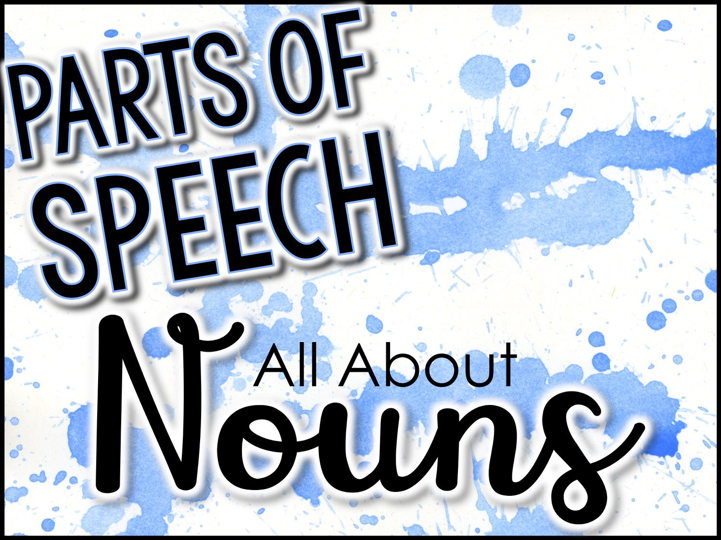
Parts of Speech
Nouns
All About

Slide 2
Nouns
A noun is a person, place, thing, or idea
There are many different kinds of nouns:
Common
Proper
Abstract
Concrete
Compound
Collective
Count
Non count

Slide 3
Common Nouns
A common noun can be ANY person, place, thing, or idea.
Do not capitalize common nouns.
Examples:
firefighter (person)
town (place)
book (thing)

Slide 4
Proper Nouns
A proper noun names a person, place, or thing.
Proper nouns are ALWAYS capitalized.
Examples:
Chief Wilson (firefighter) (person)
Kansas City (town) (place)
Where the Red Fern Grows (book) (thing)

Slide 5
Common vs. Proper Nouns
Common Noun
Proper Noun
teacher
cookie
restaurant
school
city
state
country
dog
explorer
Mr. Davis
Chips Ahoy
Surf’s Up Grill
Clover City High School
Austin
Texas
The United States
Boomer
Christopher Columbus
A noun will be EITHER a common or a proper noun.

Slide 6
Abstract Nouns
An abstract noun is a type of noun that is intangible.
You cannot see, touch, taste, smell, or hear abstract nouns.
Examples:
love
courage
knowledge

Slide 7
Concrete Nouns
A concrete noun can be experienced with one of the five senses.
You can see, touch, taste, smell, or hear concrete nouns.
Examples:
lightning (you can see it)
thunder (you can hear it)
ice cream (you can touch and taste it)

Slide 8
Abstract vs. Concrete Nouns
Abstract Noun
Concrete Noun
skill
beauty
intelligence
faith
dream
information
trust
friendship
pizza
rain
writer
roller coaster
penguin
pen
house
park
A noun will be EITHER abstract or concrete.

Slide 9
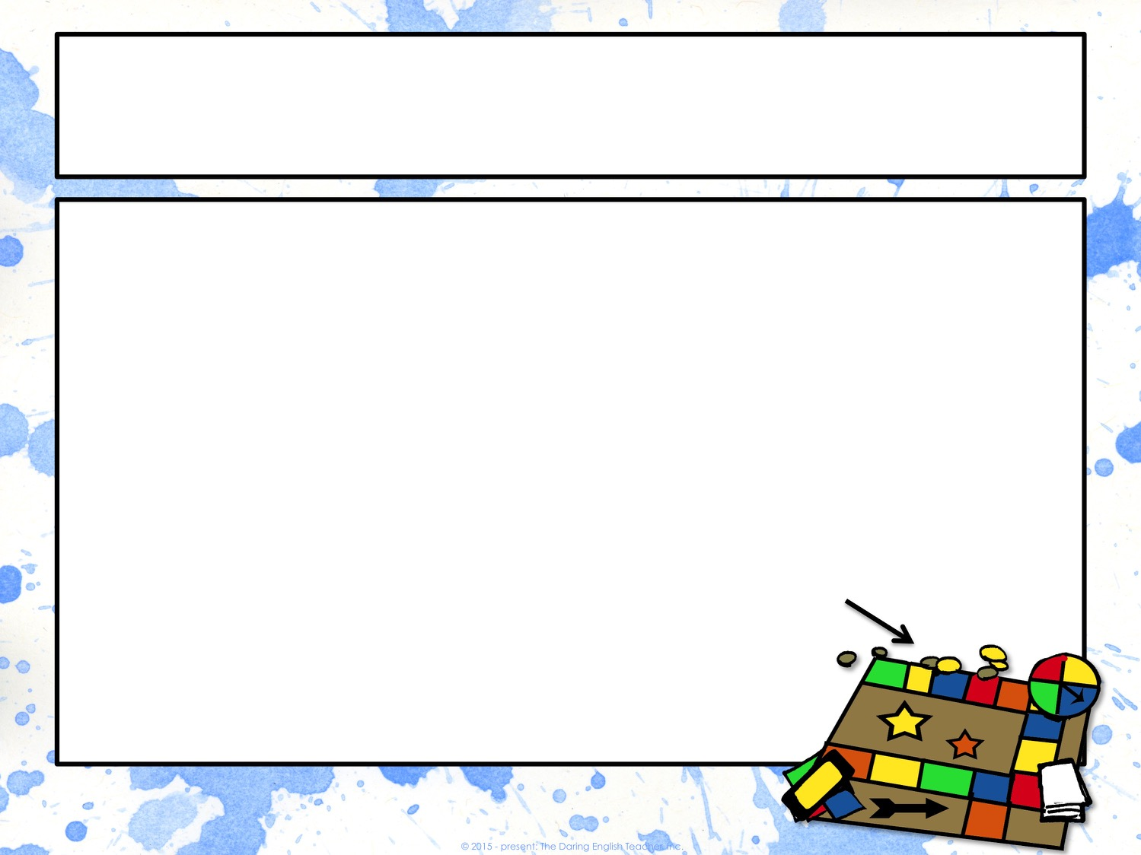
Compound Nouns
A compound noun contains two or more words that join together to make a single noun.
There are three kinds of compound nouns:
closed form
hyphenated
open form
A board game is a compound noun!

Slide 10
Compound Nouns
Closed Form
Hyphenated
Open Form
Two words are meshed together to make one word
doghouse
basketball
racecar
Two or more words are held together by hyphens
son-in-law
over-the-counter
Two separate words are considered one compound noun
post office
real estate
middle class

Slide 11
Collective Nouns
A collective noun names groups of things and people.
Examples:
family
group
majority
team
class
To avoid subject/verb agreement errors, these collective nouns need to be treated as singular nouns.
Examples:
The family held its reunion at the park.
The team celebrated its victory.

Slide 12
Count Nouns
A count noun is a noun in which you can add a number to the front of it and add an s at the end of it.
Examples:
cake/cakes
She baked a cake.
She baked five cakes.
pig/pigs
The farmer wrangled three pigs in the stable and found one pig in the barn.

Slide 13
Non Count Nouns
A non count noun is a noun that only has a single form.
You cannot add an ‘s’ to the endof a non count noun.
Examples:
music
advice
rice

Slide 14
Count vs. Non Count Nouns
Count Noun
Non Count Noun
cake/cakes
pig/pig
book/books
park/parks
sofa/sofas
rainstorm/rainstorms
bag/bags
happiness
flour
homework
furniture
rudeness
weather
baggage
A noun will be EITHER a count or non count noun.

Slide 15
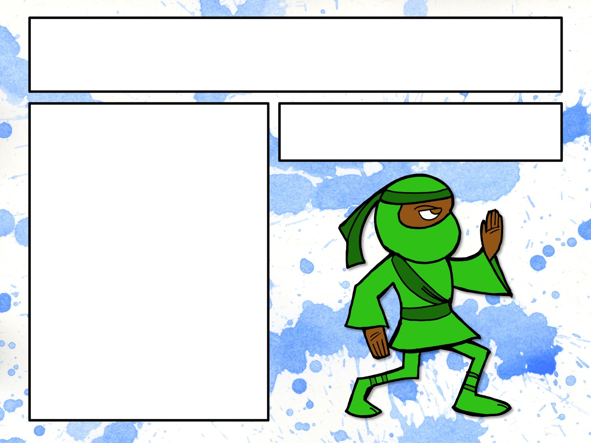
Classify the Noun
Common or Proper?
Abstract or Concrete?
Count or Non count?
Compound?
Collective?
ninja

Slide 16
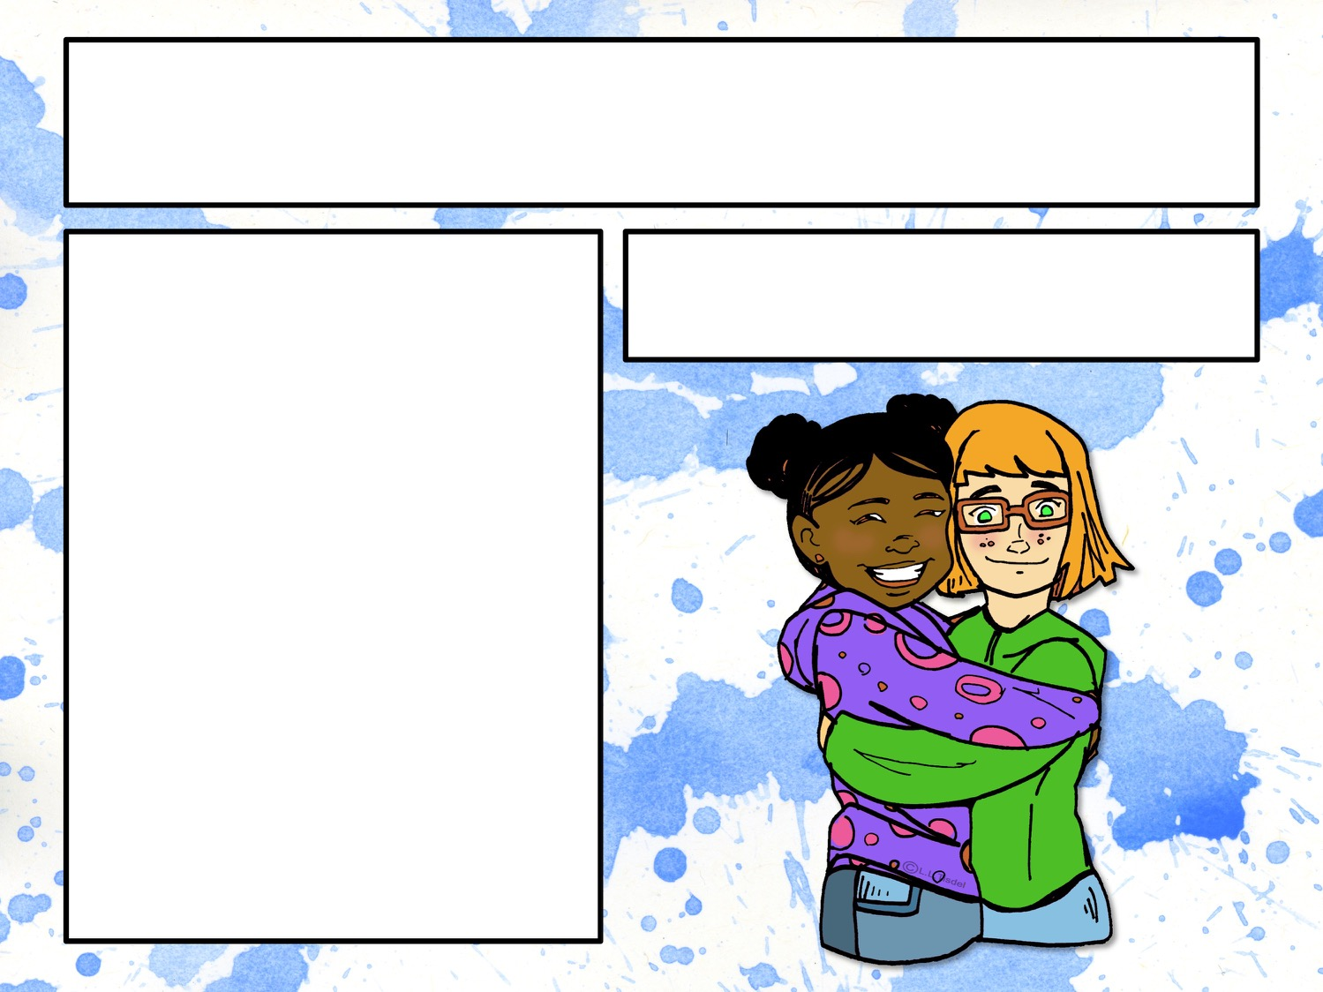
Classify the Noun
Common or Proper?
Abstract or Concrete?
Count or Non count?
Compound?
Collective?
friendship

Slide 17

Classify the Noun
Common or Proper?
Abstract or Concrete?
Count or Non count?
Compound?
Collective?
ice

Slide 18
Classify the Noun
Common or Proper?
Abstract or Concrete?
Count or Non count?
Compound?
Collective?
Ice cube

Slide 19
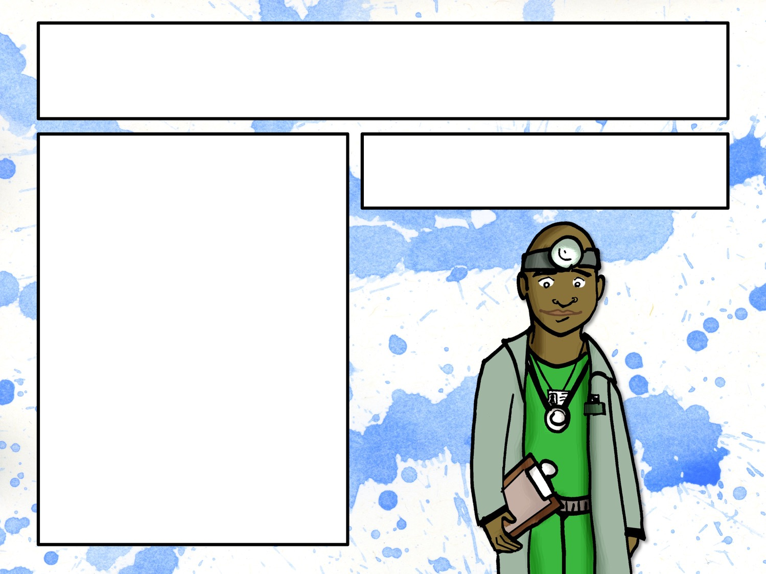
Classify the Noun
Common or Proper?
Abstract or Concrete?
Count or Non count?
Compound?
Collective?
Dr. Mason

Slide 20

Classify the Noun
Common or Proper?
Abstract or Concrete?
Count or Non count?
Compound?
Collective?
love

Slide 21
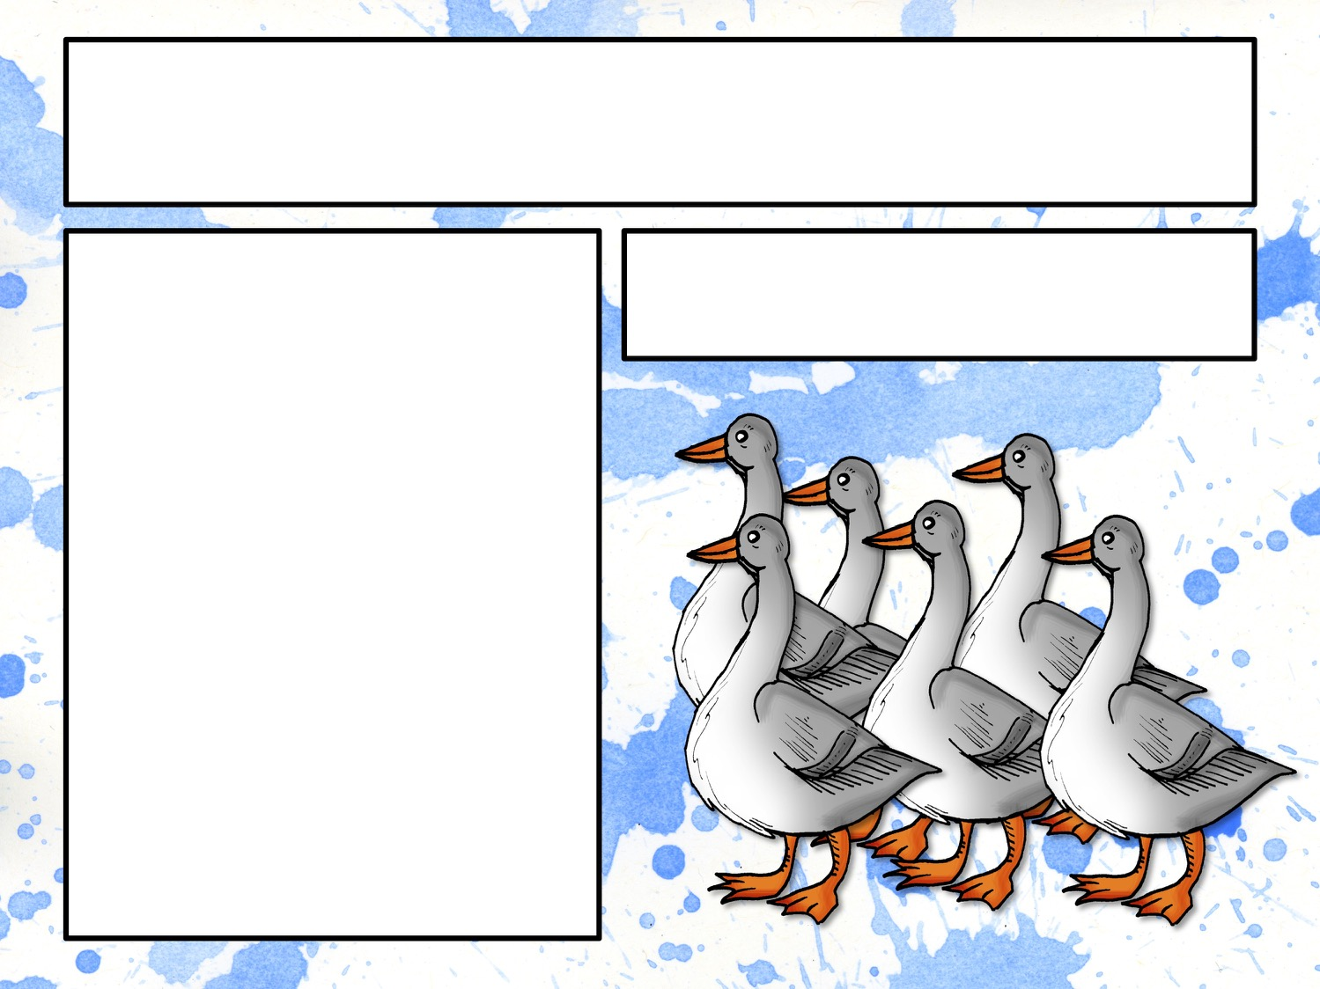
Classify the Noun
Common or Proper?
Abstract or Concrete?
Count or Non count?
Compound?
Collective?
flock

Slide 22
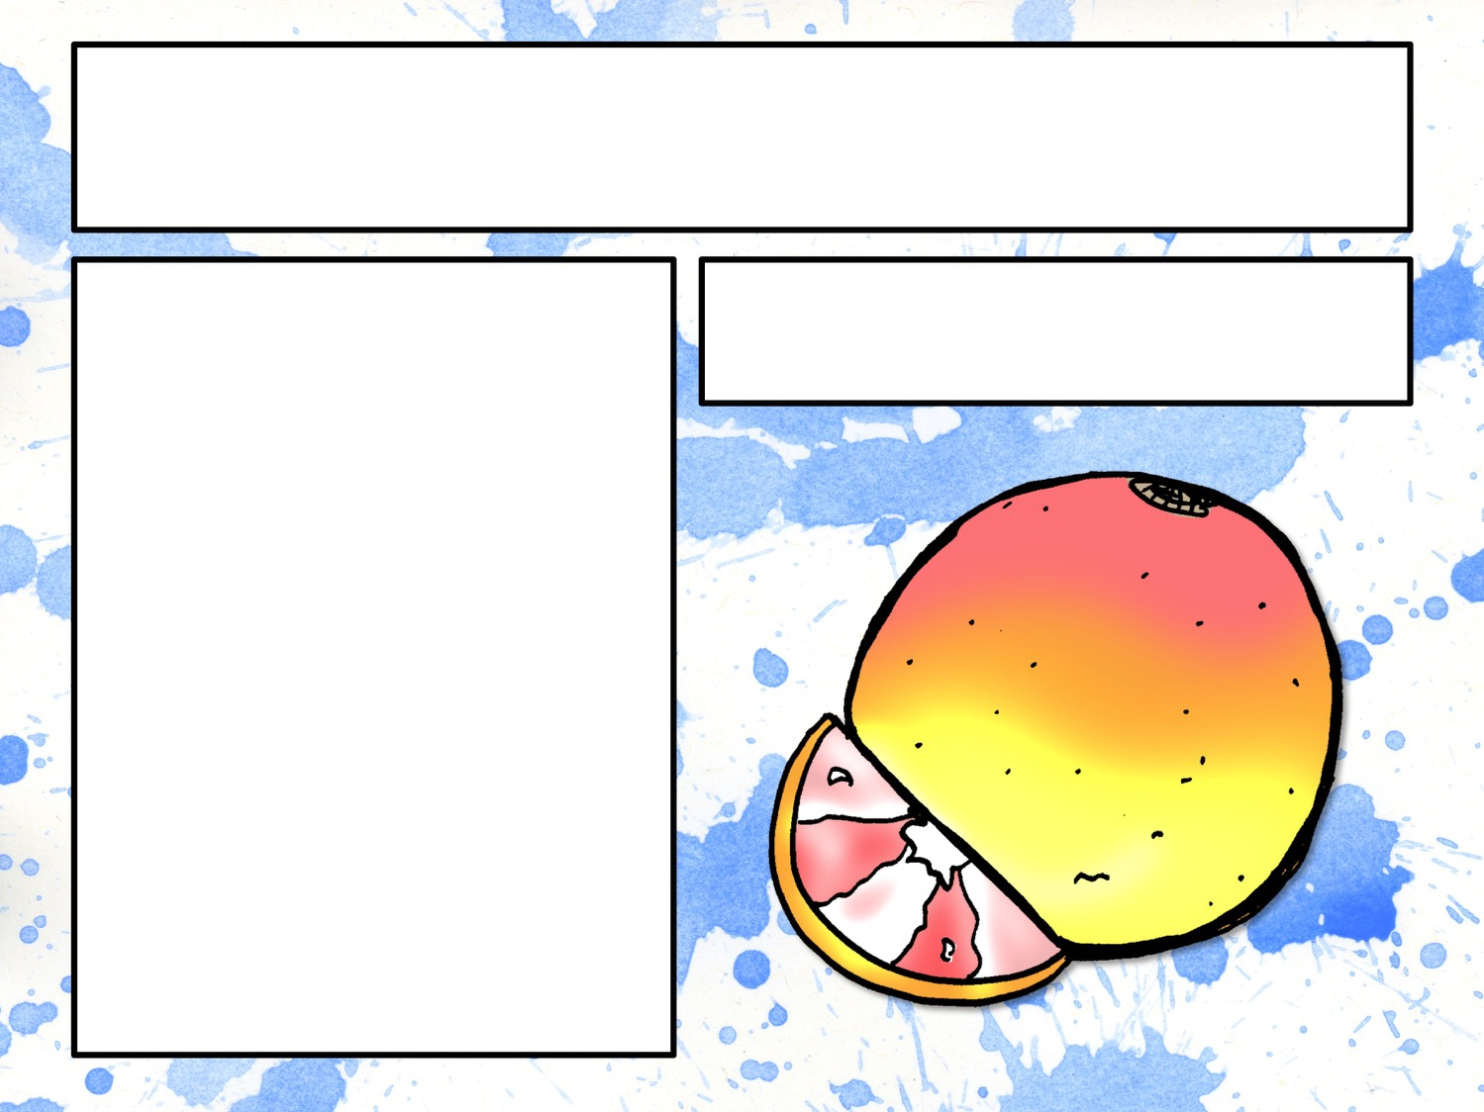
Classify the Noun
Common or Proper?
Abstract or Concrete?
Count or Non count?
Compound?
Collective?
grapefruit

